Slide 1


Capstone Project Azure – Batch G2 Check Point 1
11th February 2022

Slide 2
Contents
Case Study – Introduction
Check Point 1 – Approach
Task 1.1(Data Manipulation using Python)
Task 1.2 (SQL-Oracle)
Task 1.3 (Statistical Analysis using Python)
Team Contribution
Group Members

Slide 3
Case Study - Introduction
Domain: Automobile Industry
About: The XYZ automobile company in India wants to enter the business of selling used cars. They would like to analyze the business challenges before the venture.
Challenges: They want to understand the factors affecting the pricing of cars in the market, since those may be very different from the new car market. Essentially, the company wants to know:
Which variables are significant in predicting the price of a used car?
How well those variables describe the price of a car
Based on various market surveys, the consulting firm has gathered a large dataset of different types of used cars across the market.
Data Dictionary: Refer to the table.
Column Name | Description
Sales_ID | Sales ID
Name | Name of the used car
Year | Year of the car purchase
km_Driven | Total km driven
Region_Code | Code representing unique Region name
City_Code | Code representing City
State_Code | Code representing unique state name
Postal_Code | Postal code of the area
Fuel | Fuel type
Seller_Type | Who is selling the car
Transmission | Transmission type of the car
Owner | Owner type
Mileage | Mileage of the car
Engine | engine power
Max_Power | max power
Seats | Number of seats
Sold | used car sold or not
Target Column | Description
Selling_Price | Current selling price for used car

Slide 4
Check Point 1 – Approach
Task 1.1 and 1.3 – Approach
Reviewed all the data set.
Generated one repository file from the lookup files.
Converted all the fields into appropriate data types, so that it will be easy to read data and analyze.
After all the above steps, we tried to analyze which all fields are going to impact Selling Prices and what are the relationships between the other fields which can lead to the Sales of the cars.
Task 1.2 - Approach
All the entity files were reviewed and created the entity relationship model.
Transferred the same data to load it to corresponding tables in Oracle database and run the SQL queries.

Slide 5
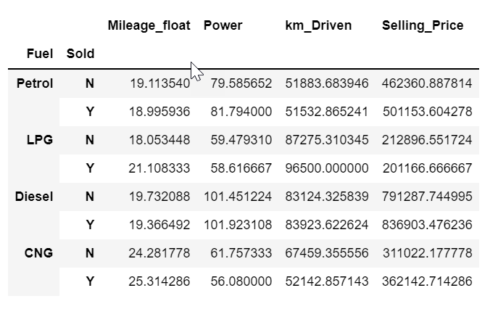
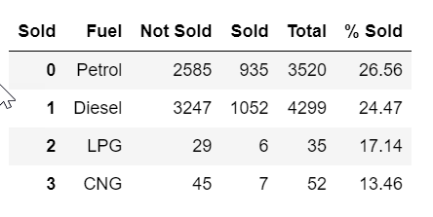
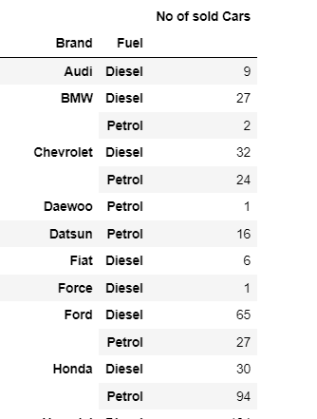
Task 1.1(Data Manipulation using Python)
Here are some indicative types of analysis we performed:
Q1. How the sold cars depend on the Fuel, Mileage, Power and Selling Price?
Selling price vs (Km driven, Power, and Mileage) of different fuel cars.
Percentage of sold cars for different fuel cars.
Conclusion:
Selling price of cars are more for those with high power and diesel cars.
Percentage of petrol cars sold more than any other fuel cars, but number of sold diesel cars are more.
Q2. How is Fuel related to Brand?
Total sold cars vs fuel type of cars.
Conclusion:
More number of sold cars are Diesel cars of almost all the brands.

Slide 6
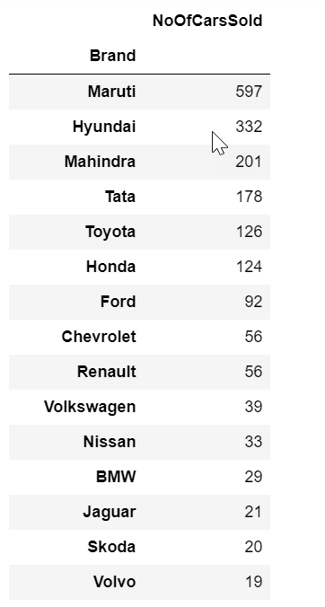
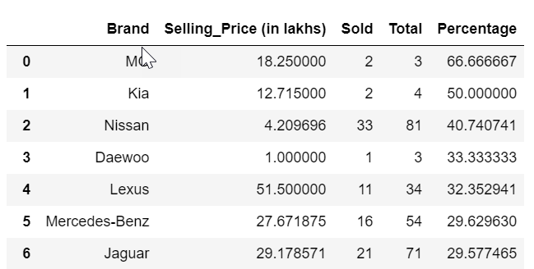
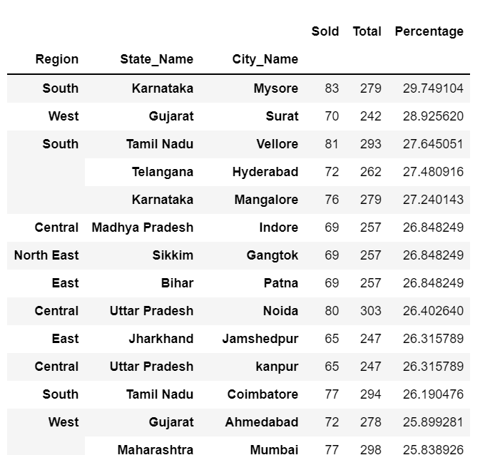
Task 1.1(Data Manipulation using Python) (Cont..)
Q3. Which Brands are selling the most?
Total number of sold cars and percentage of sold cars of different brands.
Conclusion:
Number of Maruti Brand cars are sold more, but percentage of MG Brand cars are sold more.
Q4. Are their any specific locations selling the more ?
Number and Percentage of sold cars w.r.t Region, State and City.
Conclusion:
Number and Percentage of sold cars are more in Southern Region City Mysore which is situated in Karnataka State.

Slide 7
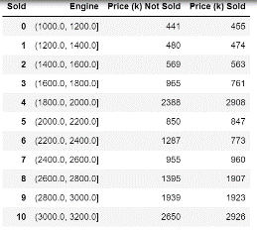
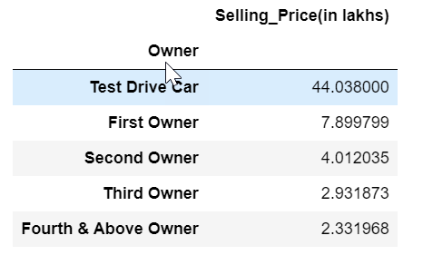
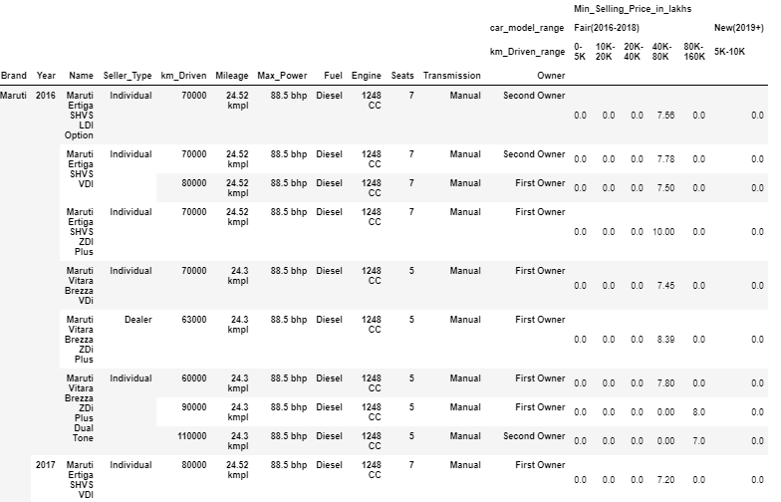
Task 1.1(Data Manipulation using Python) (Cont..)
Q5. Which factors which might help in Selling Prices?
Owner vs selling price.
Engine range vs selling price.
Conclusion:
Avg. Selling Price of Test Drive Cars are more.
Based on the ranges we concluded selling price of cars are more if range of engine is high.
Input Checklist: Designed the checklist of minimum selling price.
User provided some parameters such as {Brand: Maruti, Fuel: Petrol, Approximate mileage: 25 kmpl}.
Conclusion:
Company can come up with minimum selling price based on user inputs w.r.t km driven range and model of the car(year).

Slide 8
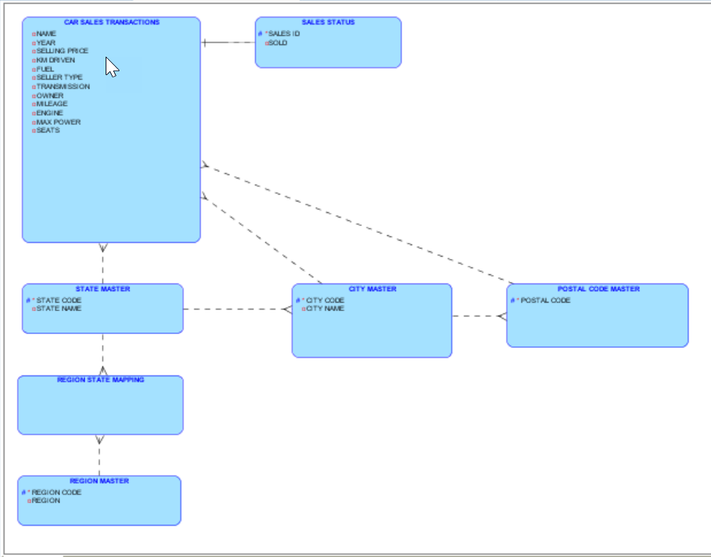
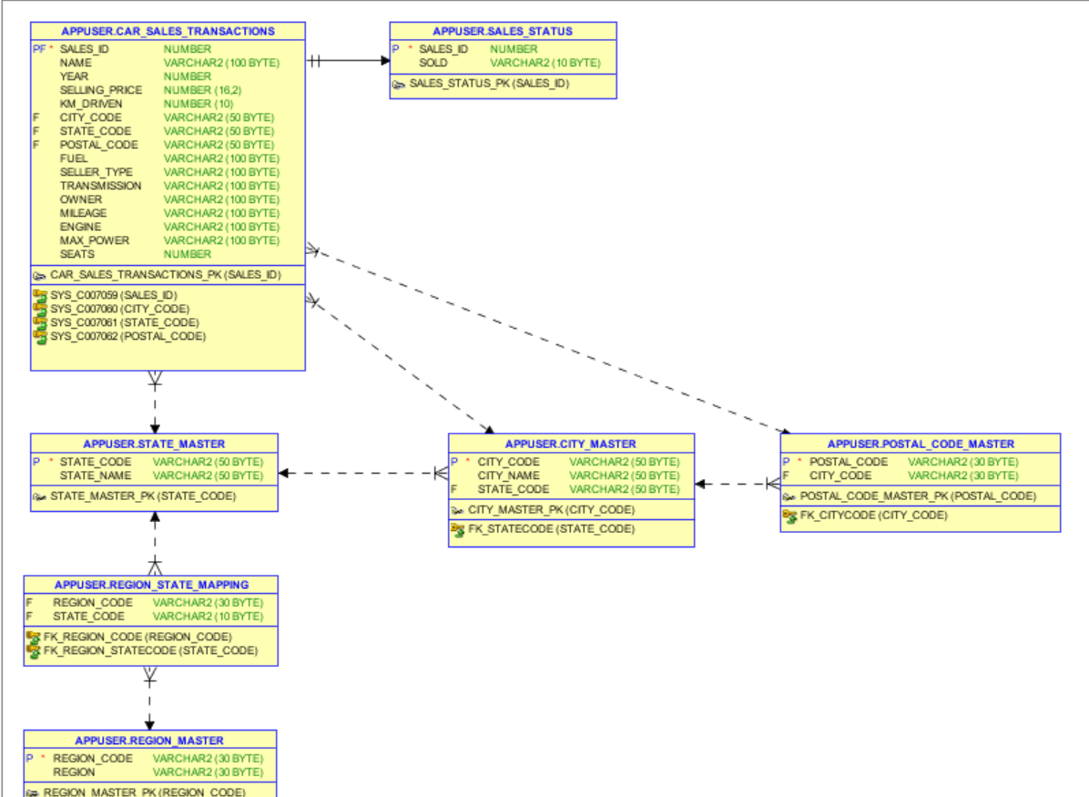
Task 1.2 (SQL-Oracle)
Stage 1: ER Model
Logical Model
Relational Model

Slide 9
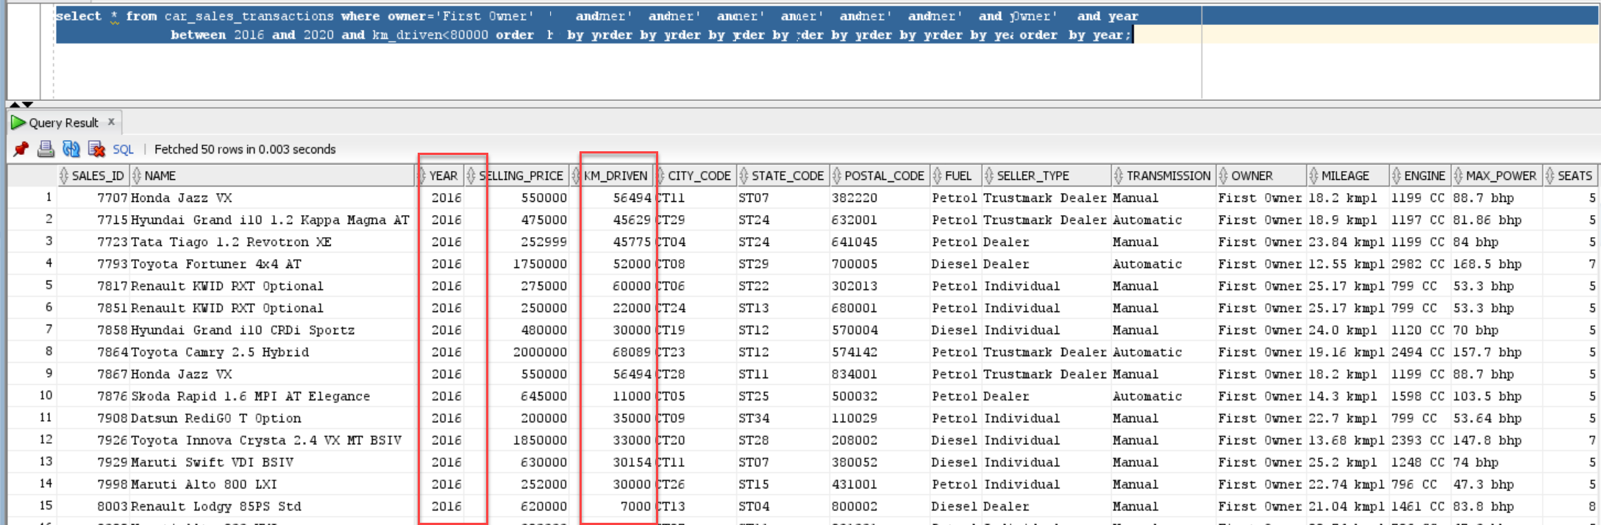
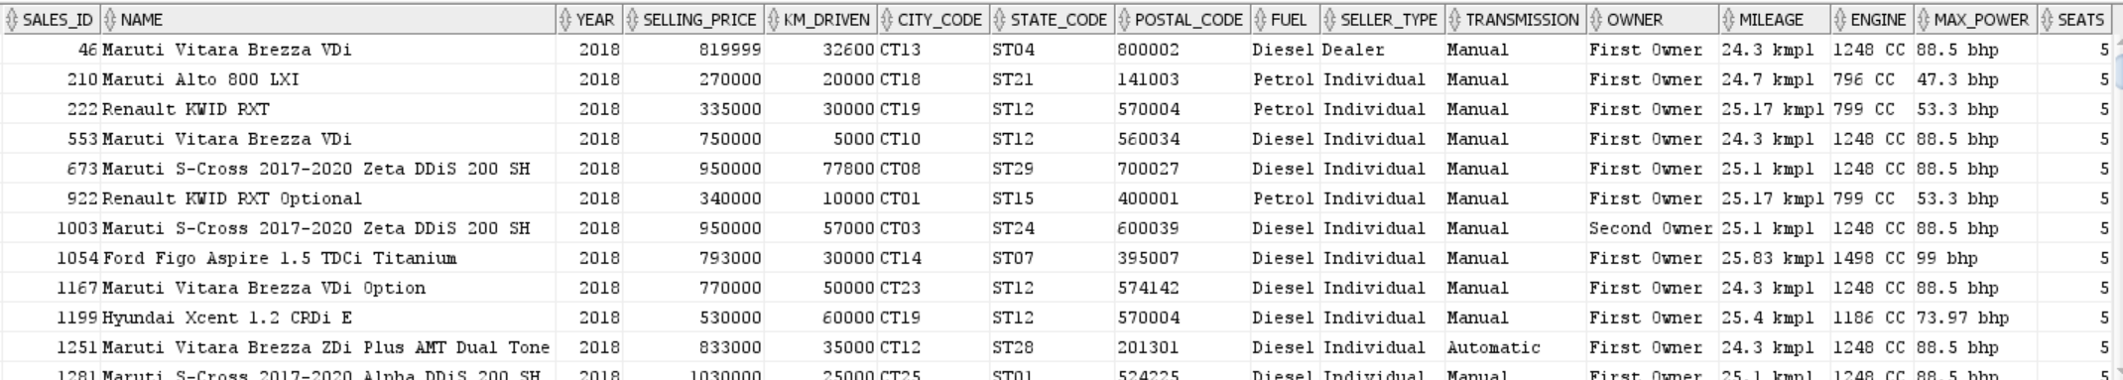
Task 1.2 (SQL-Oracle) (Cont..)
Stage 2: Queries
Generate Info of the cars which is of the type first owner and the year of car purchase is between 2016-2020 and the number of kms driven is less than 80,000.
Generate Info of all the cars whose average mileage is around 25 kmpl and year of car purchase is between 2018-2020 which has minimum seating of 4-5 and fuel type is diesel.

Slide 10
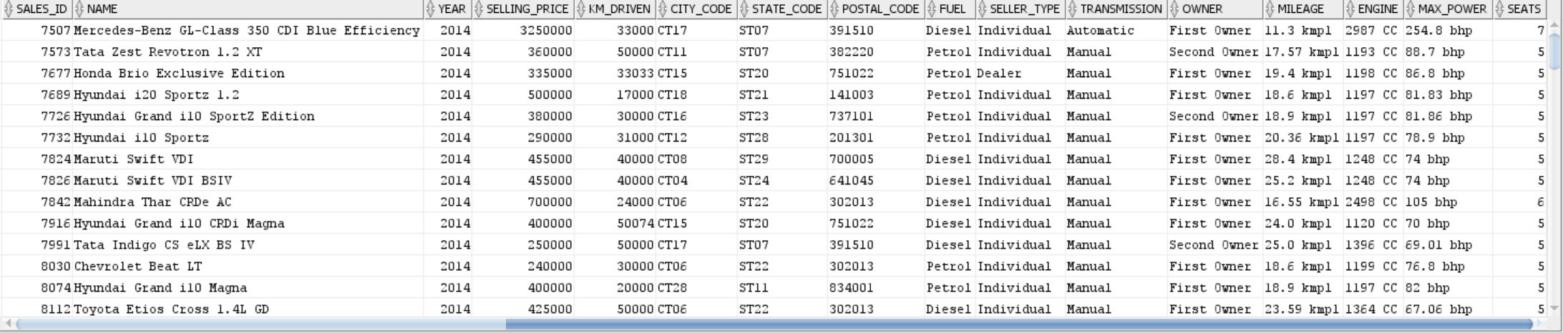
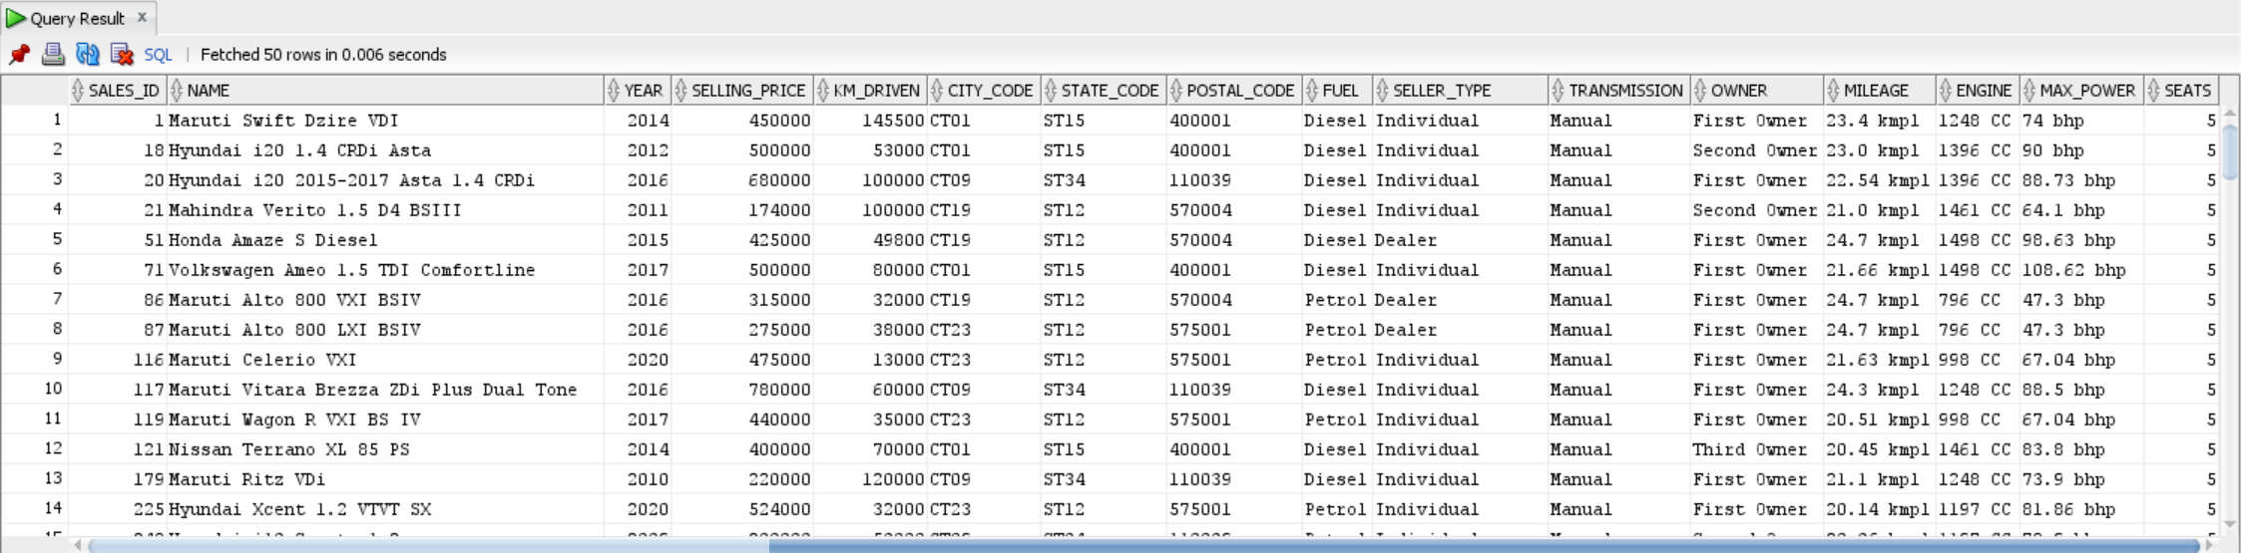
Task 1.2 (SQL-Oracle) (Cont..)
Generate Info of all the cars which are not sold, and seller-type is individual or dealer and also which has been used for less than 60000 kms and year of car purchase is 2014-2020.
Generate Info of all the cars which are manual and automatic whose mileage ranges between 20-25kmpl approximately and also which is within these cities(Washington, New York City, Chicago, Los Angeles), (Mumbai, Delhi, Mysore, Mangalore)
Generate Info of all the cars which belong to honda category could be either first owner and second owner and also fuel type is petrol and average mileage should be 25kmpl and which are not sold and seating arrangement should be minimum 4.
No rows Selected

Slide 11
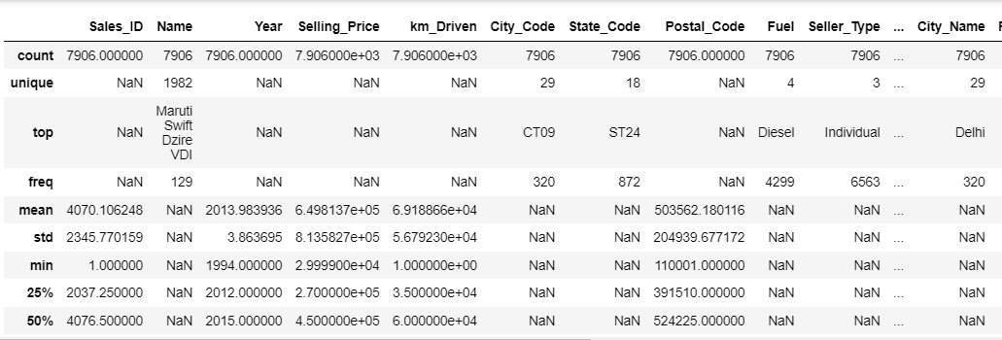
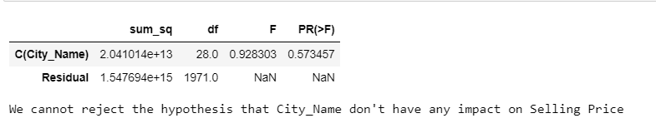
Task 1.3 (Statistical Analysis using Python)
a. Descriptive statistics for both numerical and categorical and draw few insights from them.
We analyzed here that Year has an impact on Selling Price.
Perform relevant hypothesis testing (t, chi-Square, Anova tests)
Test the impact of different independent variables (IV) on dependent variables (DV) – ‘Selling Price’ using Anova Test.
Conclusion: We performed Anova Test for different set of entries such as for City Name and Selling Price to identify whether City Name has impact on Selling Price or not. Our conclusion was “we cannot reject the hypothesis that City_Name don’t have any impact on Selling Price”.
City_Name – p value > 2.5%; Don’t have impact​
Fuel – p value < 2.5%; Have Impact​
Transmission – p value < 2.5%; Have Impact​
Owner - p value < 2.5%; Have Impact​
Year - p value < 2.5%; Have Impact

Slide 12
Team Contribution

Slide 13





Group Members
Harsh Singh
Hitesh Gulati
Lakshi Bansal
Miska Gowri Sankar
Satish Kanagala Naga

Slide 14
Thank you

Slide 15
About Deloitte
Deloitte refers to one or more of Deloitte Touche Tohmatsu Limited, a UK private company limited by guarantee (“DTTL”), its network of member firms, and their related entities. DTTL and each of its member firms are legally separate and independent entities. DTTL (also referred to as “Deloitte Global”) does not provide services to clients. In the United States, Deloitte refers to one or more of the US member firms of DTTL, their related entities that operate using the “Deloitte” name in the United States and their respective affiliates. Certain services may not be available to attest clients under the rules and regulations of public accounting. Please see www.deloitte.com/about to learn more about our global network of member firms.
Copyright © 2020 Deloitte Development LLC. All rights reserved.

